Slide 1
Digital Portfolio
STUDENT NAME: Shafiya Sarwath Kounain H.I
REGISTER NO AND NMID: astvu37537524u18004
DEPARTMENT: Bsc. Computer Science
COLLEGE: COLLEGE/ UNIVERSITY : TAW College, Thiruvalluvar University.

Slide 2
PROJECT TITLE
Flavors Unfolded: A Digital Portfolio for Food Criticism.

Slide 3


AGENDA
Problem Statement
Project Overview
End Users
Tools and Technologies
Portfolio design and Layout
Features and Functionality
Results and Screenshots
Conclusion
Github Link
3/21/2024 Annual Review

Slide 4

PROBLEM STATEMENT
In today’s digital era, food critics and culinary storytellers need more than traditional written reviews to engage with a global audience. Most existing food review platforms focus narrowly on text-based ratings, leaving limited space for immersive storytelling, visual impact, or cultural context.
There is a lack of a comprehensive digital portfolio that not only highlights written reviews but also integrates multimedia elements such as food photography, video reviews, recipe critiques, and cultural narratives. Additionally, with the rapid rise of food trends, dietary diversity, and social media influence, food critics require a modern, responsive, and interactive platform to showcase their expertise and connect with food enthusiasts across devices (desktop, laptop, tablet, and mobile).
This project aims to solve these challenges by designing and developing a Food Critic Digital Portfolio — a clean, responsive, and interactive web platform that combines reviews, videos, photography, cultural storytelling, and social integration in one place.

Slide 5

PROJECT OVERVIEW
The Food Critic Digital Portfolio is a responsive and interactive web platform designed to showcase the work of a modern food critic. It goes beyond traditional reviews by integrating multimedia elements such as written reviews, video reviews, and food photography. The portfolio also highlights recipe critiques, food trends, cuisine-specific insights, and cultural storytelling, making it both engaging and informative.
The design follows a clean, food-inspired grid layout with storytelling elements, interactive hover effects, and a built-in dark mode toggle for better user experience. It includes a profile section to present the critic’s identity, a social media hub for online presence, and a contact form for collaboration opportunities.
The main idea of this portfolio is to create a comprehensive digital identity for a food critic — blending reviews, creativity, and culture into one visually appealing and fully responsive platform accessible across laptops, tablets, and mobile devices.

Slide 6

WHO ARE THE END USERS?
Food Enthusiasts – People who love exploring new cuisines, recipes, and food trends.
Restaurant Owners & Chefs – To read reviews, gain feedback, and showcase their food.
General Audience – Mobile and desktop users looking for food recommendations and cultural stories.
Food Bloggers & Influencers – To connect, collaborate, or draw inspiration.
Tourists & Travelers – Searching for authentic food experiences and street food culture.
Brands & Food Companies – For partnerships, sponsorships, and product promotions.
Recruiters & Media Houses – Looking to hire critics, writers, or food content creators.
Students & Researchers – Studying food

Slide 7

TOOLS AND TECHNIQUES
HTML5 – For structuring the content of the portfolio.
CSS3 – For styling, grid layouts, responsive design, and food-inspired themes.
JavaScript (ES6) – For interactivity (dark mode, animations, storytelling effects).
Google Fonts (Poppins) – For attractive, readable typography.
Unsplash / Free Image Sources – For high-quality food photography.
YouTube Embeds – For video reviews integration.
Audio Player (if podcasts were included) – To host/stream audio content.
Browser DevTools – For debugging and testing responsiveness.
Responsive Frameworks / Media Queries – To ensure mobile, tablet, and desktop compatibility.
Version Control (Git/GitHub) – For collaboration, updates, and deployment.

Slide 8
POTFOLIO DESIGN AND LAYOUT
Portfolio Design
Theme / Style
Minimalist yet vibrant (light background with orange highlights 🍊 for energy & food vibes).
Modern typography (Poppins) for readability and elegance.
Use of storytelling visuals (images, videos, reviews) to engage readers.
Balance of professional + personal touch (profile section introduces the critic).
Color Palette
Primary: Warm Orange (#ff9800) → evokes food, energy, excitement.
Secondary: White & Light Beige (#faf9f6) → clean & minimalist.
Accent: Dark Gray / Black (#333 / #121212) → for readability and dark mode.
Typography
Headings: Bold, large (2.5rem+) for emphasis.
Body Text: Medium size (1rem–1.2rem), easy to read.
Highlight Styles: Italics or badges for trends, ratings with ⭐.
Interactivity
Hover effects on cards and images (scale, shadows).
Responsive navigation bar (collapsible on mobile).
Dark mode toggle 🌙 / ☀️.
Smooth scrolling and storytelling transitions.
8

Slide 9
POTFOLIO DESIGN AND LAYOUT
Portfolio Layout
The portfolio follows a section-based grid layout with clear navigation:
Header / Hero Section
Fullscreen background image (food-related).
Title + tagline.
Navigation bar with smooth scroll links.
Profile Section (newly added)
Profile picture + short bio of the food critic.
“About Me” storytelling introduction.
Reviews Section
Grid layout cards with restaurant/cuisine reviews.
Each card: title, description, star ratings.
Video Reviews
Embedded YouTube videos.
Responsive grid for mobile/laptop views.
Food Photography Gallery
Interactive image grid.
Hover zoom effects.
9

Slide 10
POTFOLIO DESIGN AND LAYOUT
Food Trends & Culture Section
Highlighting global food trends (vegan, mocktails, street food, etc.).
Badges like 🔥 “Trending” or 🍹 “Popular”.
Recipe Reviews
Similar to reviews but focused on dishes instead of restaurants.
Interactive Storytelling Section (optional enhancement)
Timeline or carousel showing food journey/cultural exploration.
Contact + Social Media
Contact form.
Social media icons (Instagram, YouTube, Twitter).
Footer
Copyright + credits.
Consistent branding ( Flavors Unfolded ).
10

Slide 11
FEATURES AND FUNCTIONALITY
Key Features
Hero Section with Navigation
Eye-catching fullscreen header with background food image.
Smooth-scroll navigation menu for quick access to sections.
Profile / About Me Section
Food critic’s photo + short biography.
Highlights of expertise, passion, and background.
Written Reviews
Grid-based restaurant/cuisine reviews.
Star rating system ⭐⭐⭐⭐⭐ for quick evaluation.
Video Reviews
Embedded YouTube videos for immersive storytelling.
Responsive player that adapts to laptop and mobile screens.
Food Photography Gallery
Interactive image grid with hover zoom effect.
Curated food photography showcasing dishes & culture.
Podcasts Section
Audio players for listening to food-related podcasts.
Play/pause and progress bar for ease of use.

Slide 12
FEATURES AND FUNCTIONALITY
Food Trends Section
Highlight cards with badges (🔥 Trending, 🍹 Popular).
Updates on global food movements.
Recipe Reviews
Detailed breakdown of dishes, taste, and preparation.
Ratings and critic’s perspective.
Contact Section
Contact form (Name, Email, Message).
Social media links (Instagram 📸, YouTube 🎥, Podcasts 🎙️).
Dark Mode Toggle 🌙 / ☀️
User-friendly theme switcher for better readability.
Responsiveness
Mobile-friendly design with collapsible navigation.
Grid layouts adapt to laptop, tablet, and phone screens.
Animations & Interactivity
Hover effects on cards & images.
Smooth scrolling and subtle transformations.

Slide 13
FEATURES AND FUNCTIONALITY
Functionality
Navigation: Users can click menu links to jump to specific sections.
Reviews & Ratings: Displays critic’s food reviews with star ratings.
Video Embeds: Plays external YouTube videos seamlessly.
Audio Podcasts: Integrated HTML5 audio player for listening.
Gallery Interaction: Users can explore high-quality food images.
Contact Form: Collects user queries/messages.
Dark Mode: Toggles between light/dark theme with one click.
Responsive Layout: Adjusts to any screen size (desktop, tablet, mobile).

Slide 14
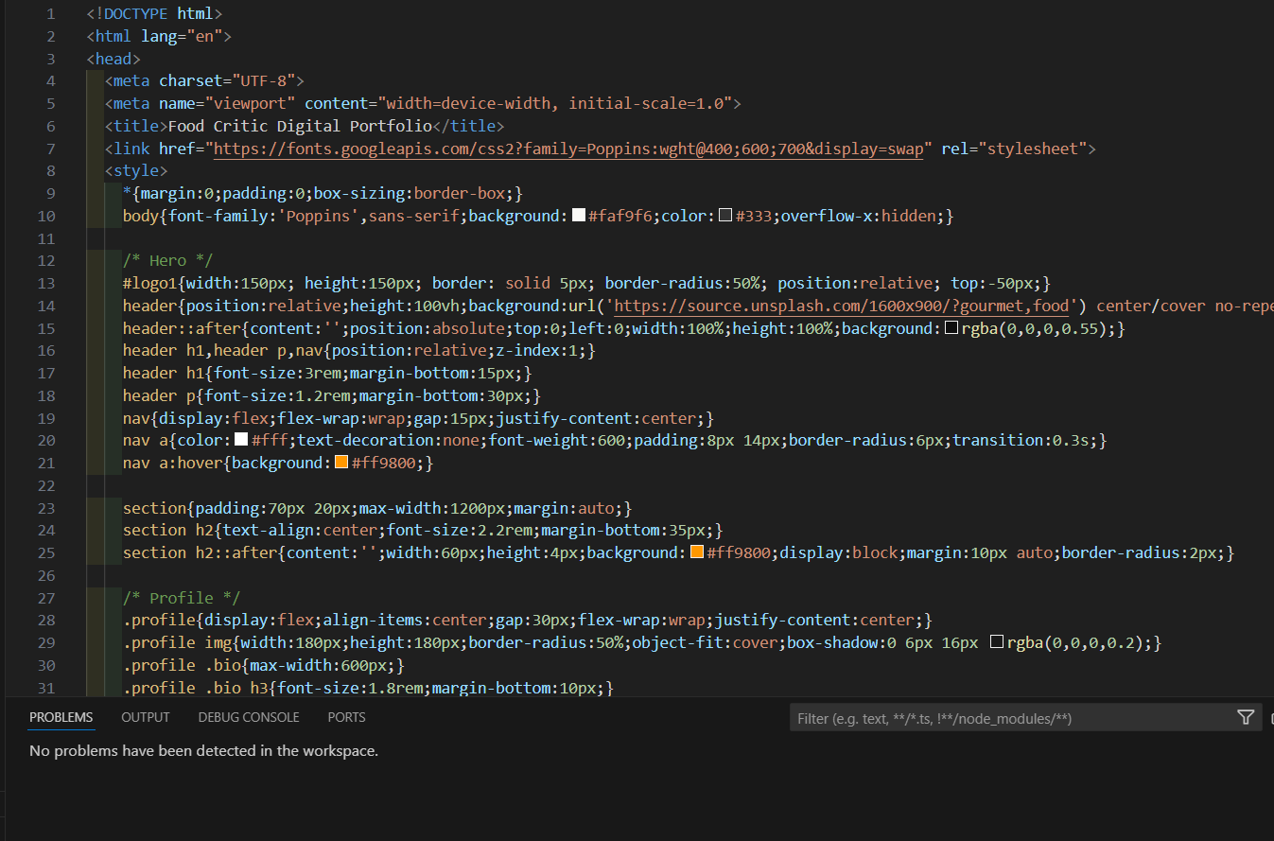

RESULTS AND SCREENSHOTS
3/21/2024 Annual Review
14

Slide 15
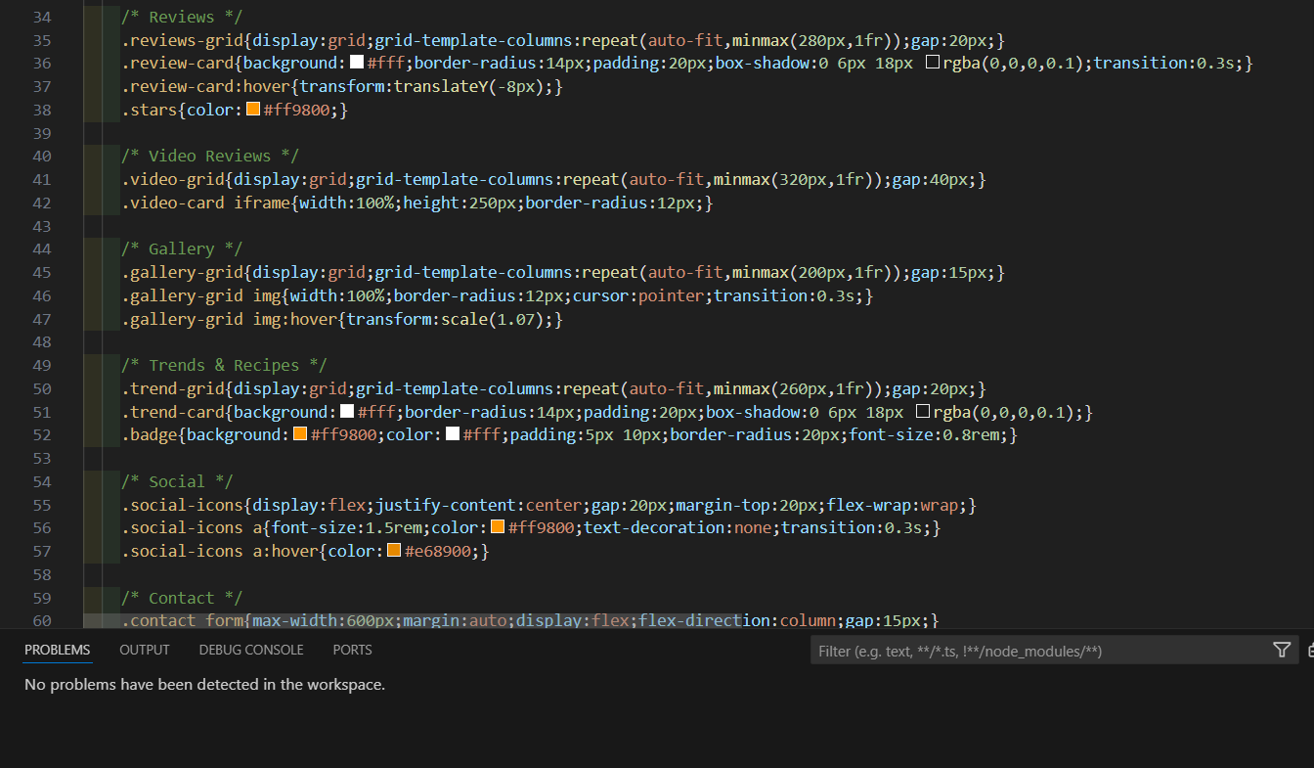
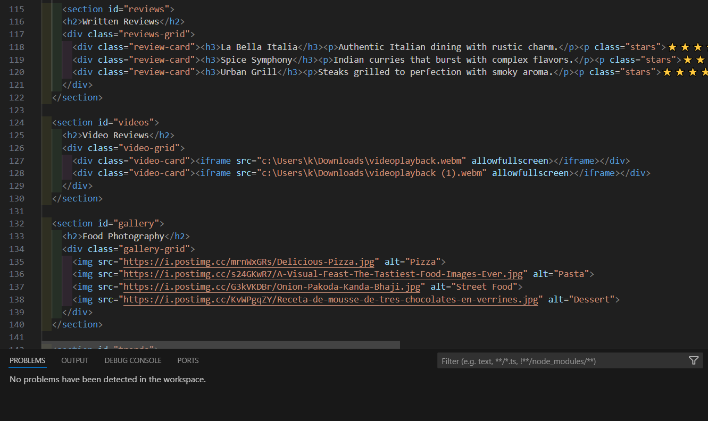
RESULTS AND SCREENSHOTS
3/21/2024 Annual Review
15

Slide 16
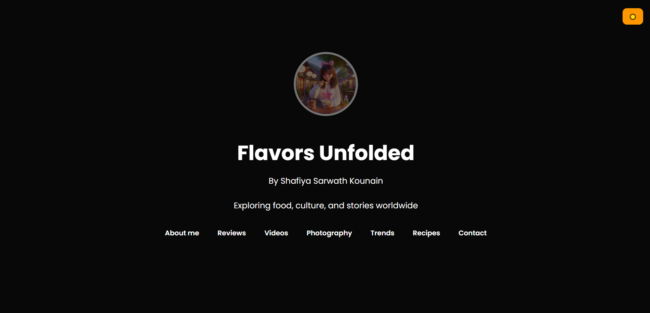
RESULTS AND SCREENSHOTS
3/21/2024 Annual Review
16

Slide 17
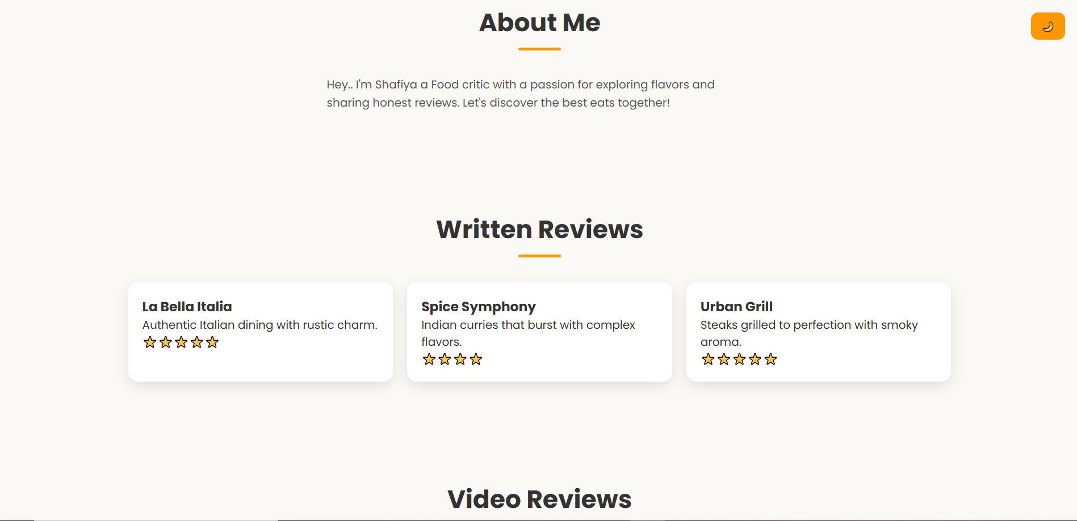
RESULTS AND SCREENSHOTS
3/21/2024 Annual Review
17

Slide 18
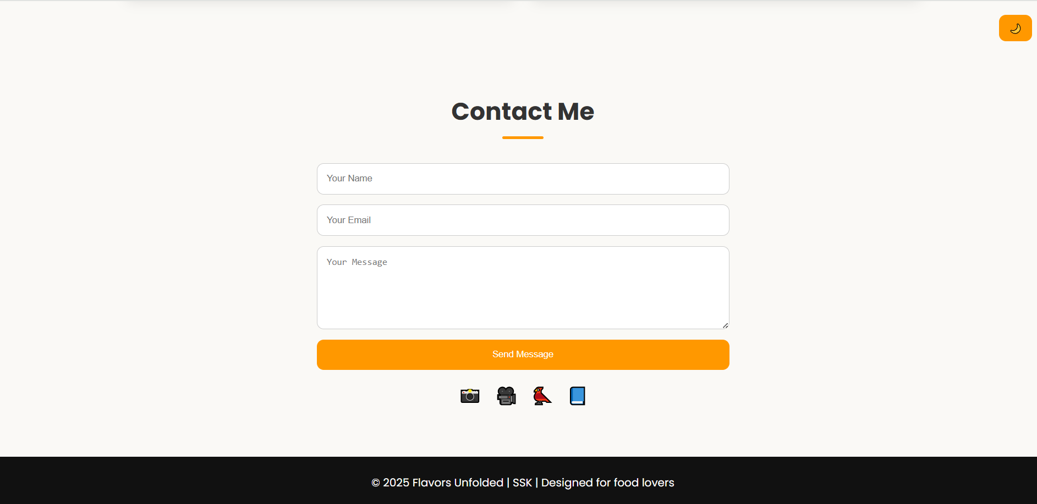
RESULTS AND SCREENSHOTS
3/21/2024 Annual Review
18

Slide 19
CONCLUSION
The Food Critic Digital Portfolio serves as an engaging platform to showcase culinary expertise through reviews, photography, videos, food culture insights, and trends. With a clean, responsive design and interactive features, it combines storytelling with technology to create a professional digital identity. This portfolio not only enhances credibility but also connects with food enthusiasts, brands, and media, making it a powerful tool for both personal branding and audience engagement.
19

